Slide 1
Something to think about
What do you think makes code easier to understand and work with?

Slide 2
Sam Attwood | s.attwood@mmu.ac.uk
Wed, 7th Dec, 2022
Collaborative coding
Coding standards, code reviews, and shared version control
Intended learning outcomes

Slide 3
Intended learning outcomes
Explain coding standards and describe why they are important when working in a collaborative environment.
Apply coding standards within the context of a manual code review.
Differentiate between coding standards that can be reviewed automatically vs. manually.

Slide 4
Why do coding standards matter?
A recent study by Stripe found that the average developer spends 42% of their time dealing with technical debt and maintenance issues.
The estimated global cost of 'bad code' is $85 billion (approx. 71 billion GBP).
Source: The $85 billion dollar cost of bad code.

Slide 5
Why do coding standards matter?
Code could be 'bad' because it is insecure or unsafe. Code of this kind can have negative consequences beyond economic loss:
Privacy / dignity loss
Psychological distress
Public shaming
...

Slide 6
Something to think about
What do you think makes code easier to understand and work with?

Slide 7
What are coding standards?
Coding standards are conventions for writing code.
These conventions usually describe things like:
How code should be formatted
How variables should be named
Aspects of a programming language that should not be used
...

Slide 8
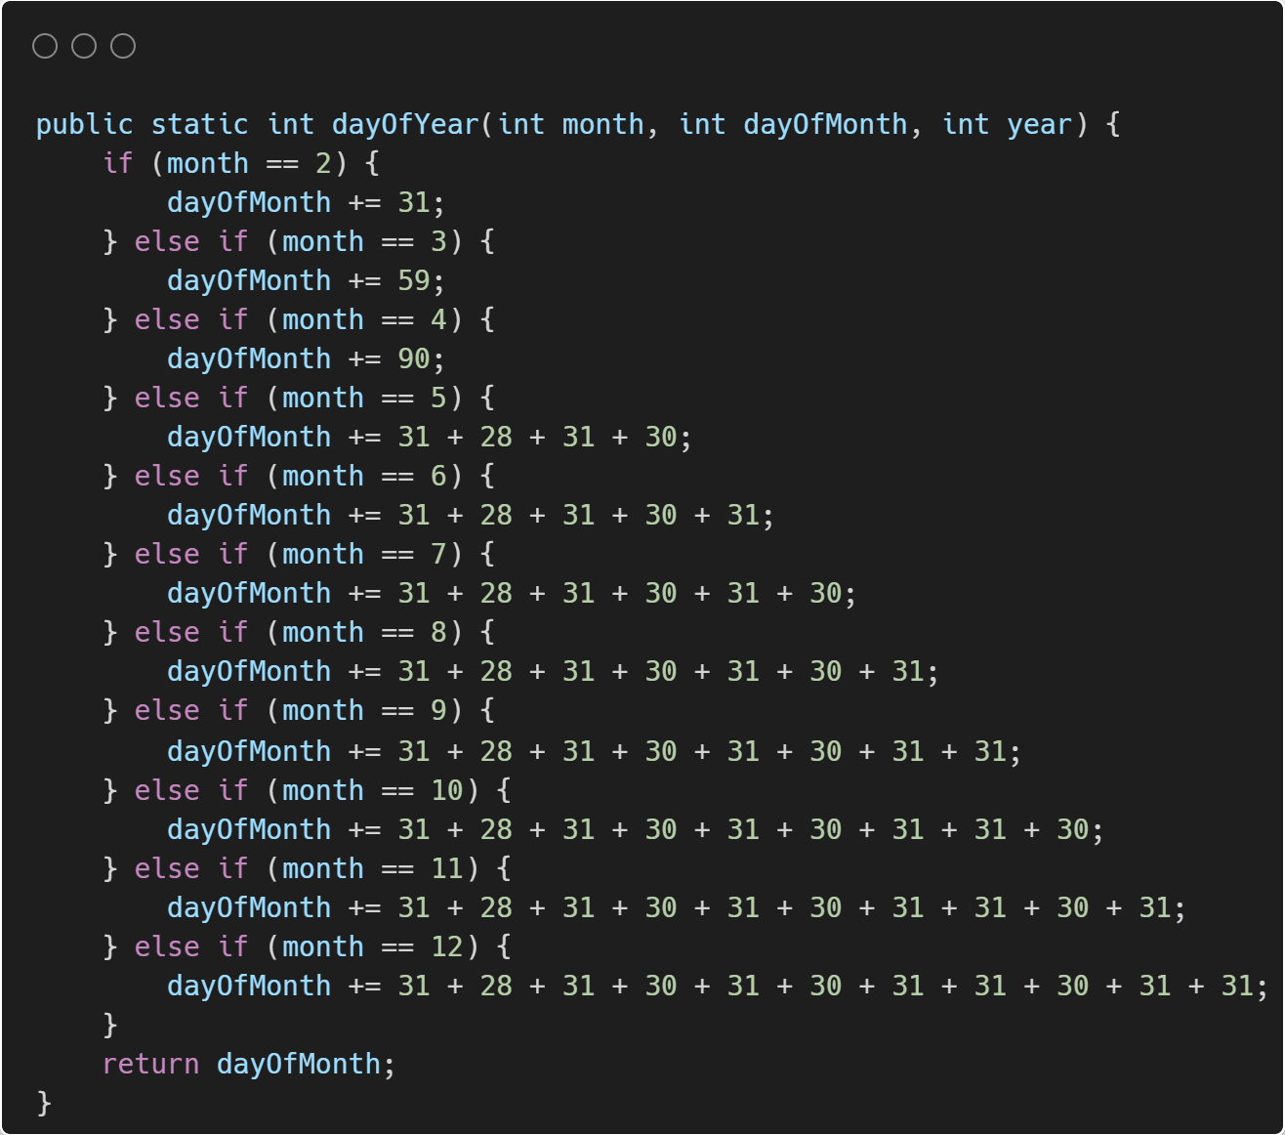

Slide 9
#1: Don't Repeat Yourself (DRY)
Motivation: Duplicated code is hard to maintain, so avoid copying and pasting and aim to reuse code when appropriate.
Example: Imagine if we got the no. of days in February incorrect... We'd need to update our code in at-least 8 places!
Fixes: Use variables and methods to avoid repeating yourself. For and While loops can be used to condense repetitive code.

Slide 10
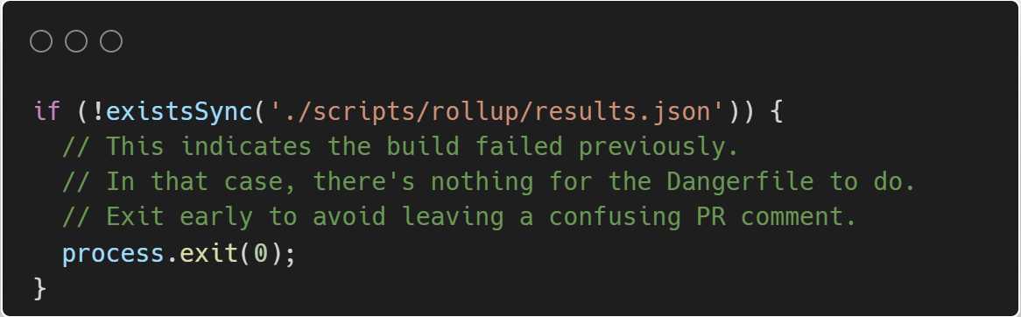

Slide 11
#2: Use comments appropriately
Is this comment really required and what value does it add?
Is there a way to improve the code so this comment is unnecessary?
Am I only covering myself by adding this comment?
Source: Five code comments you should stop writing // and one you should start (freecodecamp.org)

Slide 12
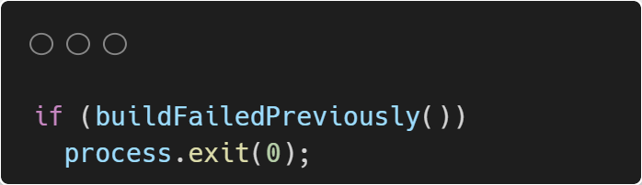

Slide 14
#3: Fail fast
Motivation: Code should reveal bugs early, this way they are easier to fix.
Example: Imagine if a user called dayOfYear but passed month and dayOfMonth in the wrong order... What would happen?
Fixes: Check values and throw exceptions when you encounter a situation you weren't expecting.

Slide 15
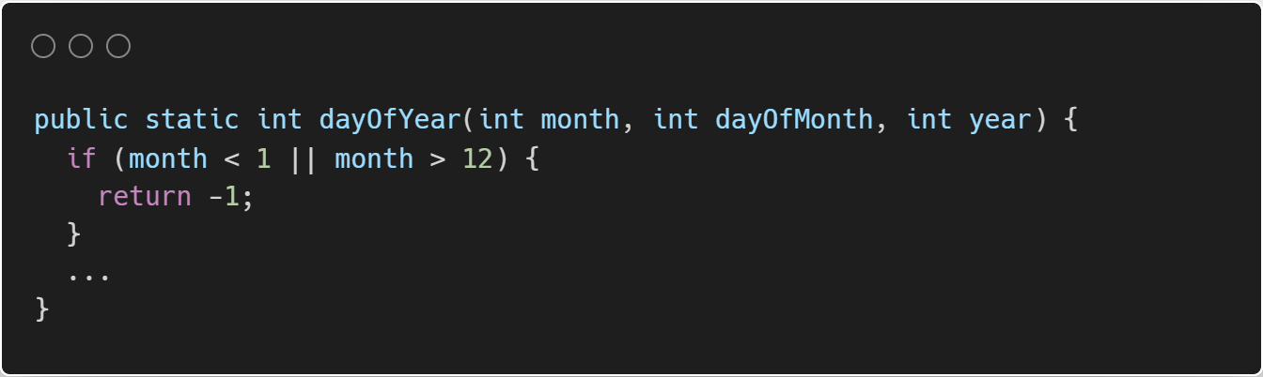

Slide 16
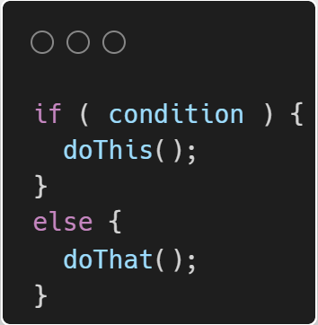
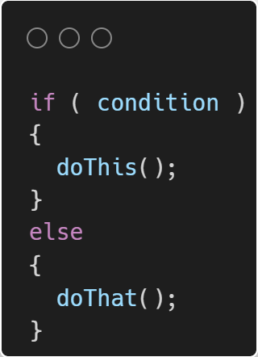
Coding standards can vary and be opinionated. This is especially true of style guides.
Company A
Company B

Slide 17
How should we enforce coding standards?
Coding standards can be enforced via code reviews.
Code reviews have many benefits:
Help ensure standards are met
Provide learning opportunities / help knowledge transfer
Create a culture of mentorship
...

Slide 18
How should we review code?
Golden rule: be constructive and respectful.
When doing a code review, ask:
What standards does the code violate?
What does the code do well?
How should I convey this feedback?
Hint: Emojis can help! (Code Review Emoji Guide)

Slide 19
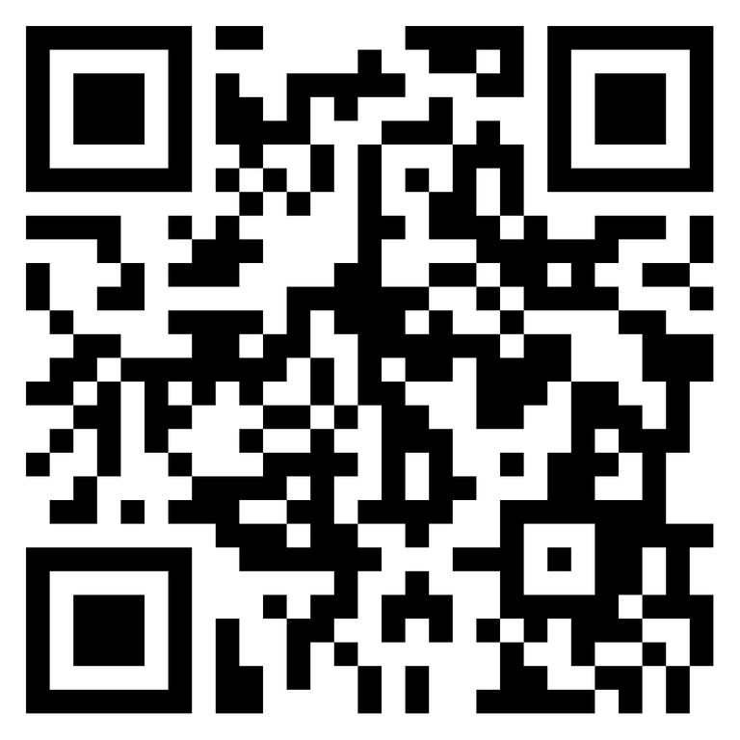
Write a code review
https://bit.ly/FSD-code-review

Slide 20
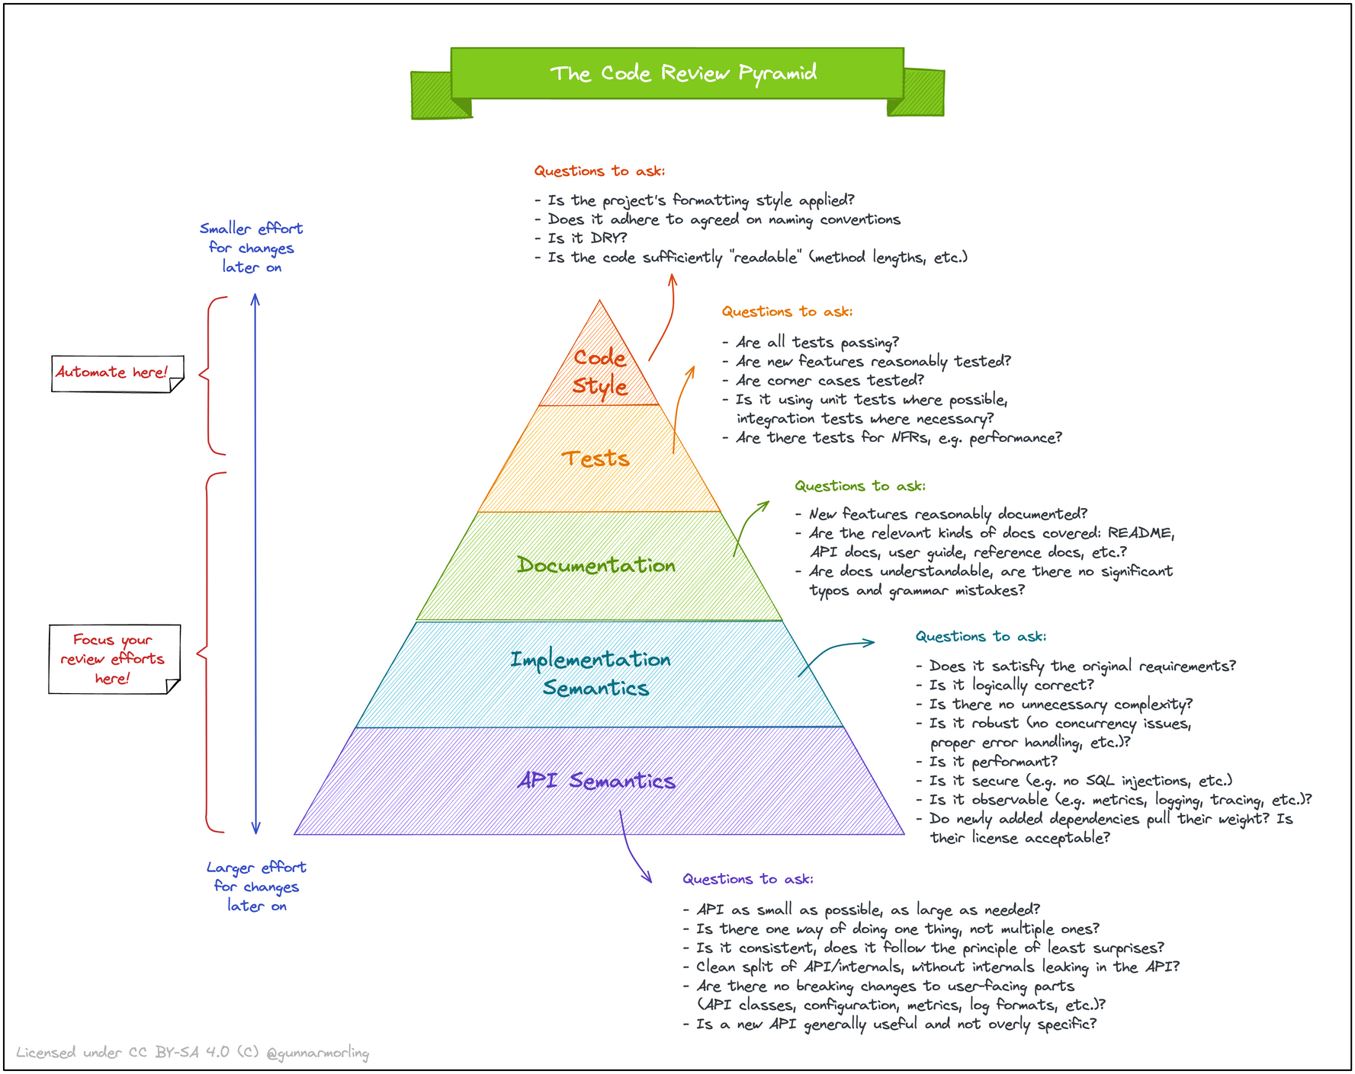

Slide 21
Recap: Intended learning outcomes
Explain coding standards and describe why they are important when working in a collaborative environment.
Apply coding standards within the context of a manual code review.
Differentiate between coding standards that can be reviewed automatically vs. manually.

Slide 22
Further reading
samattwood9/collab-coding-221207: Further reading and resources for guest lecture on collaborative coding. (github.com)
samattwood9/streamlit-starter-tour (github.com) - example of automation and practices to facilitate collaborative coding on the AI Foundry project.

